Slide 1

CSG1105 / CSG5130
Applied Communications
Chapter 15
The Internet

Slide 2
Objectives
Describe the basic organization of the Internet
Understand the role of different operating systems used on the Internet
Explore the elements of the World Wide Web
Explain the purpose of a browser and its relationship to HTML and XHTML

Slide 3
Objectives (cont’d.)
Discuss the usefulness of Cascading Style Sheets, CGI, JavaScript, and Java applications
Identify the elements of a Virtual Private Network
Use Web-based instant messaging applications
Install a Web server

Slide 4
The Organization of the Internet
Several top-level domain categories
  Internet host name
    Shows assigned category
Domains registered on appropriate root servers
  Locally administered Domain Name Server allows host configuration
Domain name associated with an IP address
  Resolved via DNS
Growing Internet popularity
  Shortage of available networks

Slide 5
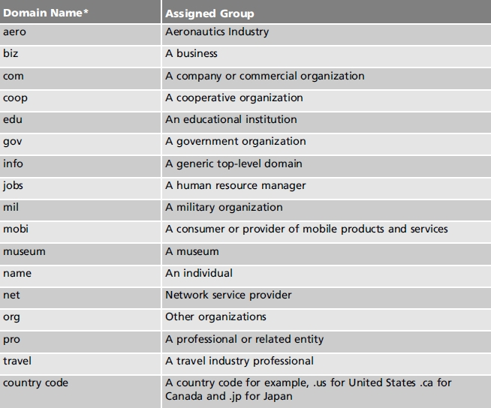
Table 15-1 Common top-level domain names

Slide 6
The Organization of the Internet (cont’d.)
Network Address Translation (NAT)
  Multiple network devices on a local network
    Mapped to IP addresses on an external network
  Internal IP addresses mapped on a rotating basis
  NAT table
    Contains known mappings
    Initialized with a set of translations
  Advantages
    Reduces number of outside IP addresses required
    Enhances security
    Hides internal IP addresses

Slide 7
The Organization of the Internet (cont’d.)
Internet Connection Sharing (ICS)
  One computer:
    Contains one connection to the ISP, second connection to the local network
    Acts as a gateway to ISP
  Alternatively, multiple computers share a single Internet connection
    Requires cable modem/DSL router
    One port connects to the single ISP connection, other ports provide access for local network connections
    Web-based interface typically provided

Slide 8
Windows and the Internet
Windows NT/200X Server operating system services
  DHCP, DNS, RAS
  Windows Internet Naming Service (WINS)
    Translates Windows computer names to IP addresses
    Name-to-IP mappings dynamic database
    Automatically adjusts entries as IP addresses reassigned
  Windows computer may utilize its own mapping table before relying on WINS
    LMHOSTS file

Slide 9
Other Operating Systems on the Internet
Variety of operating systems available
  Linux
  Unix
  Mac OS
  OpenVMS
  MVS
  NetWare
Necessary for vendors to provide a TCP/IP stack
All seamlessly participate on the Internet

Slide 10
World Wide Web
World Wide Web (WWW) or Web
  Referred to as a collection of Web servers
    Provides access to host computer files
  Hypertext Transfer Protocol (HTTP) in use on the Internet
    Many products enhance HTML
Web browser
  Client program to access Web server files (Web pages)
    Three elements: content, organization, layout
    Uses Uniform Resource Locator (URL) to point to specific page of information

Slide 11
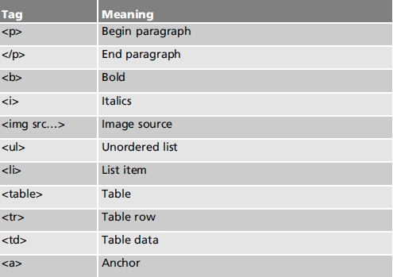
HTML
Hypertext Markup Language (HTML)
  Core component Web page information
  HTML source code has an overall syntax, structure
    Consists of many different tags
    Instructs browser when preparing graphical Web page
Table 15-2 Assorted HTML tags

Slide 12
HTML (cont’d.)
When processing HTML source
  Browser ignores white space
HTML editors
  Create and maintain Web pages
  What you see is what you get (WYSIWYG) option
  Provide samples, image editing, conversion tools
Web page categories
  Static
  Dynamic
  Active

Slide 13
HTML (cont’d.)
Extensible HTML (XHTML)
  Based on XML
    Standard Generalized Markup Language (SGML) subset
  Open standard recommended by World Wide Web Consortium
  Fully compatible with HTML
  Advantages over HTML
    XML complaint; HTML 4 reformulated into XHTML 1.0; new browsers support XHTML
  Validation services provided

Slide 14
HTML (cont’d.)
Cascading Style Sheets
  Method to incorporate style, layout elements into Web pages
    Improved page appearance level of control
  Many elements
    Background, text, font, border, outline, margin, padding, list, table, dimension, classification

Slide 15
CGI
Common Gateway Interface (CGI)
  Mechanism designed to provide a dynamic Web environment
    Incorporates a client server processing model
  Environment variables
    Contain client and server environment information available to the CGI application
  CGI application development languages:
    C/C++/C#, Visual BASIC, Java, Perl, many others

Slide 16
Java
Programming language used to create:
  Traditional computer programs
  Active Web pages using Java applets
    Specified by the Java applet when Web page displayed (not HTML coding process)
Java applet program
  Transferred from an Internet host to Web browser
  Executed by browser on a Java virtual machine

Slide 17
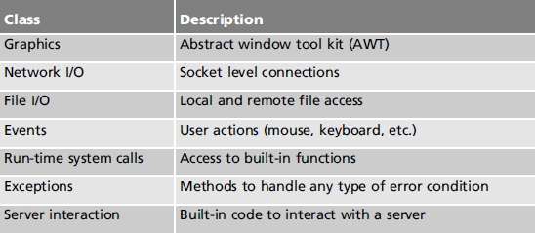
Java (cont’d.)
Java consists of:
  Programming language
  Run-time environment
  Class library
Table 15-3 Java class library categories

Slide 18
JavaScript
Programming language
  Performs Web client side processing
    Relieves server processing requirements
Included on modern browsers
Performs many common activities
  Scripts downloadable from the Web
    Can include on Web page with little effort
Performs custom activities as required

Slide 19
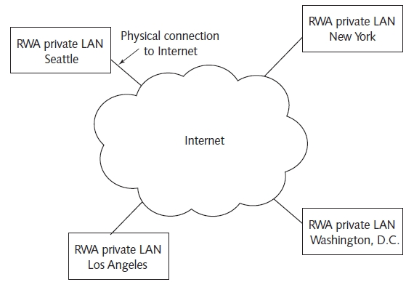
Virtual Private Networks
Allows private LAN secure communication
  Through an untrusted public network (Internet)
Figure 15-6 RWA Software VPN (physical view)

Slide 20
Virtual Private Networks (cont’d.)
Only authorized network members access data
Uses IP tunneling protocol and security services
  Transparent to private network users
Private LAN connected to the Internet
  Can connect to other LANs by combining tunneling, encryption, authentication
Tunneling
  Data transferred through the public network in an encapsulated form
    All data including sender, destination addresses enclosed within a packet

Slide 21
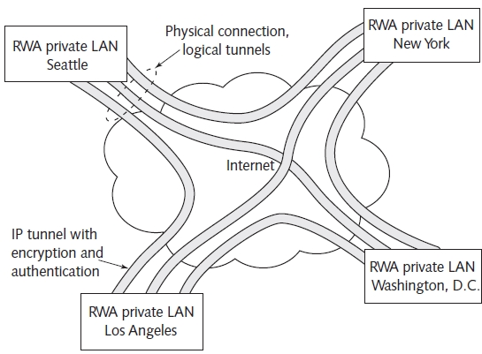
Figure 15-7 RWA Software VPN (logical view)

Slide 22
Virtual Private Networks (cont’d.)
Complete security accomplished when data communication also encrypted and authenticated
IP Security (IPSec) standards provide:
  Tunneling, data privacy, integrity, and authentication
  Adds additional TCP/IP networking security solutions
Point-to-Point Tunneling protocol (PPTP), Layer 2 Tunneling Protocol (L2TP) support only tunneling
  Capabilities include:
    User authentication, address management, data encryption, encryption key management, support for multiple protocols to be delivered

Slide 23
Instant Messaging
Application providing capability for user to send and receive instant messages
  Delivered to recipient instantly
    Faster than electronic mail
Popular instant messaging applications
  Installed as client application program
    AOL’s Instant Messenger
    Microsoft’s Windows Live Messenger
  Without installing client software
    AIM Express

Slide 24
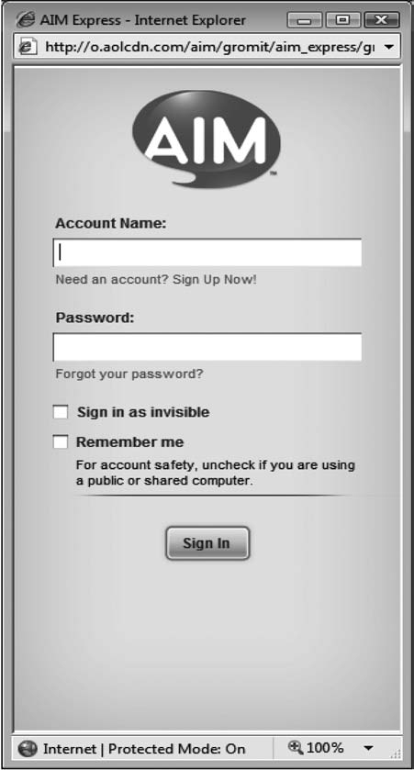
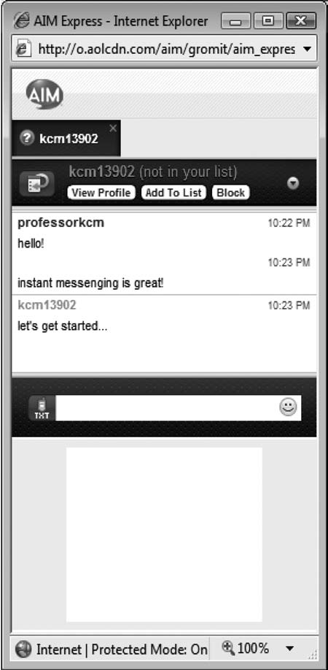
Figure 15-8 AIM Express
Instant Messaging log in screen
Figure 15-9 AIM Express
active messaging window

Slide 25
Setting Up a Web Server
Typically installed on large computer systems
  Running UNIX or Windows Server
Commonplace on personal computers
Apache Server (free and fully featured)
  Most popular Web server program
    Business and personal use
  50% of the entire Web server market
Microsoft Internet Information Services (IIS) Web server
  Popular with Windows users

Slide 26
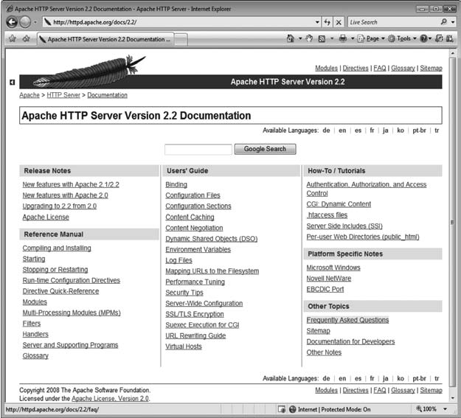
Figure 15-13 Apache HTTP Server documentation

Slide 27
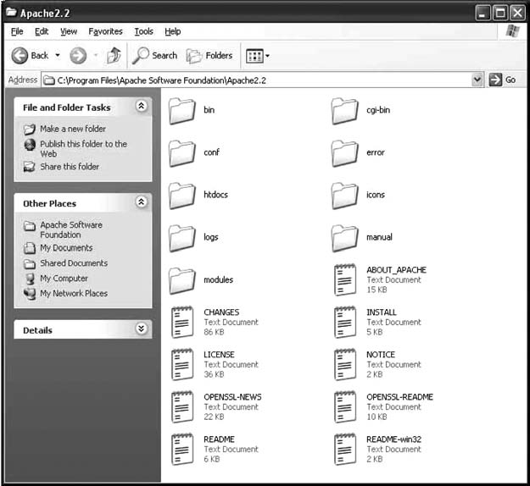
Figure 15-14 Apache HTTP Server root directory structure

Slide 28
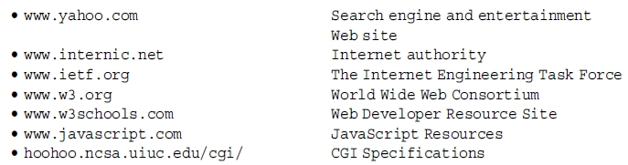
Related Sites
Service, reference, technology-based sites

Slide 29
Troubleshooting Techniques
The Internet
  Physical collection of networked computers
World Wide Web
  Logical collection of information
    Contained on computers comprising the Internet
Web page file download considerations
  Communication channel noise forcing packet retransmission
  Internet path introducing delay
  Server sending data at a limited rate
  ISP providing limited bandwidth

Slide 30
Summary
Internet organized into several domain categories
Web: HTTP in use on the Internet
  HTML: core component of Web page information
  Page categories: static, dynamic, active
  Many tools
    XHTML: preferred coding strategy
    CSS, CGI, Java, JavaScript
  Instant messages provided for users
VPN allows private LAN secure communication
Apache Server: available for almost every platform

